Slide 1
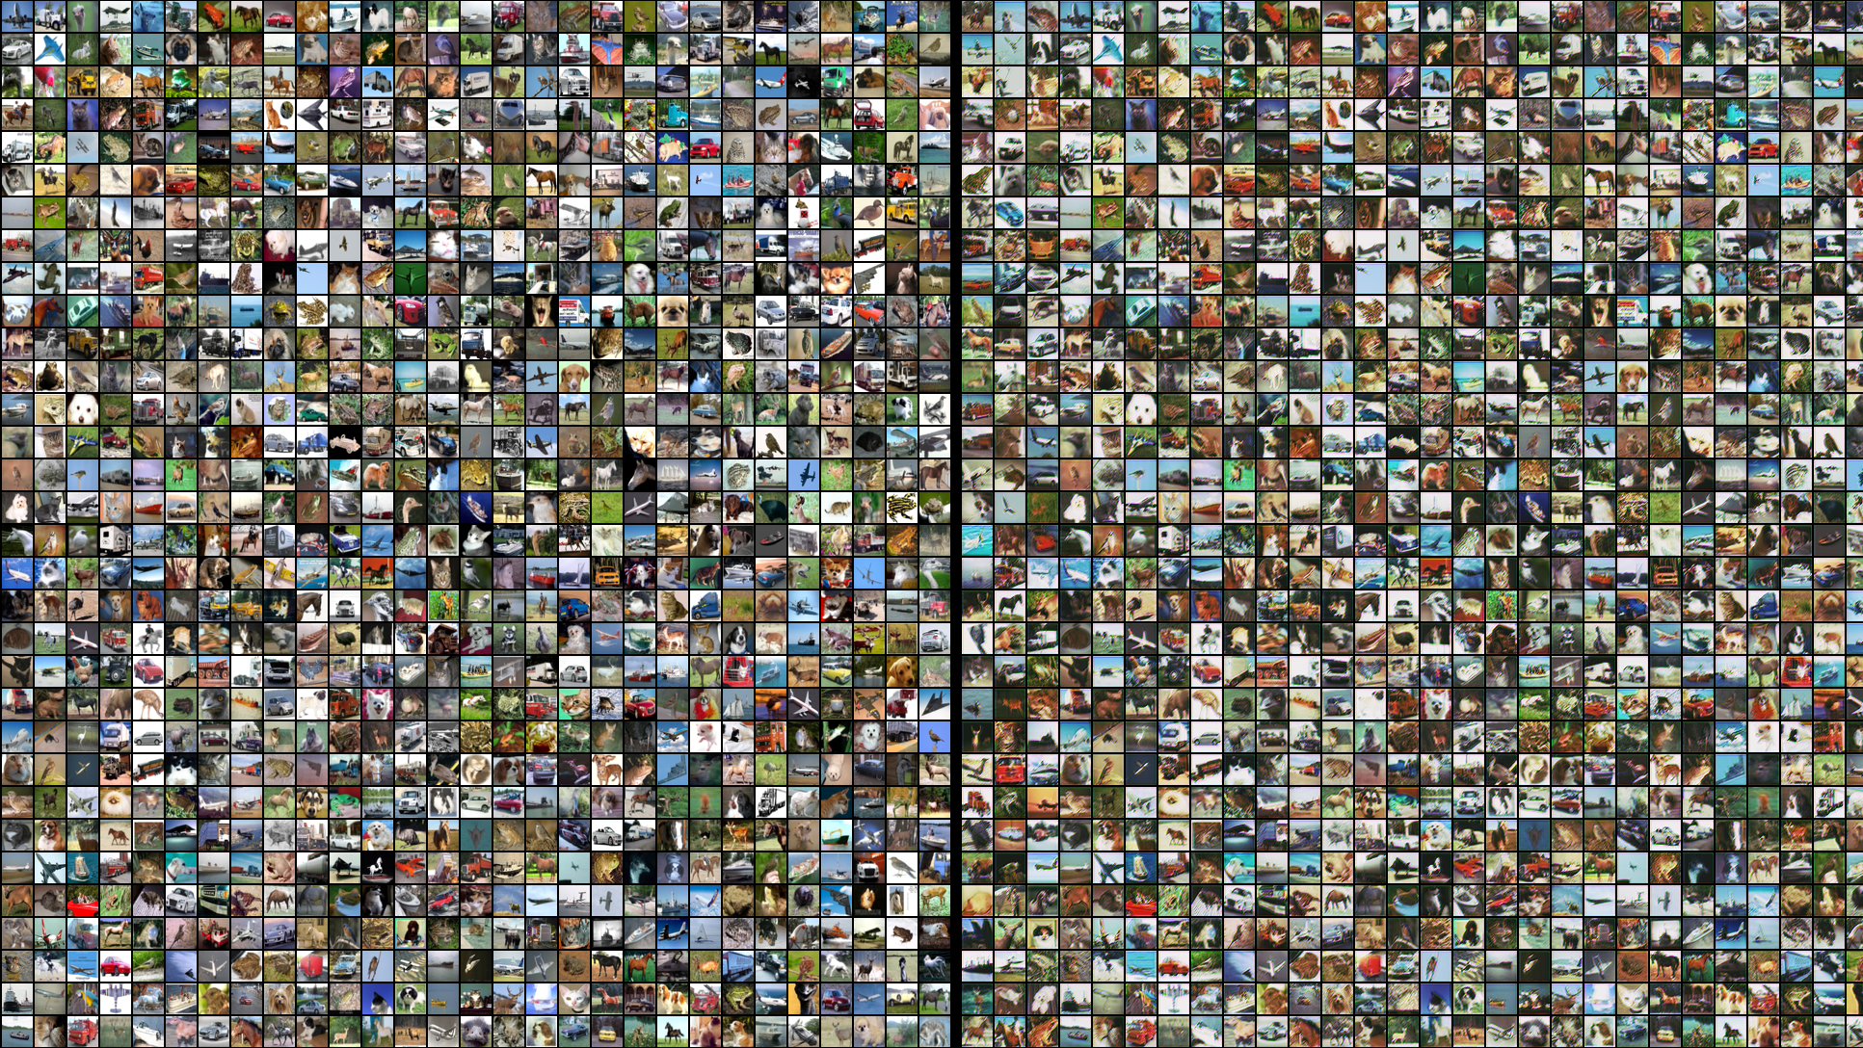
ImageNet Classification with Deep Convolutional Neural Networks
by Alex Krizhevsky, Ilya Sutskever, Geoffrey E. Hinton
presented by
Christian Stur

Slide 2
Index
Quiz
The Data
CNN Architecture
  Overview
  Data Augumentation
  ReLu and Pooling
  Local Response Normalization
  Dropout
  GPUs
Results
Future of Computer Vision
Sources

Slide 3
Image Recognition
Teach a machine to identify images on a very diverse set of objects
Large Scale Visual Recognition Challenge (ILSVRC)
→Perfect to compare progress in computer vision (Benchmark)
Example of Use-Cases:
  For driverless cars
  Product quality assurance
  Person Identification
  Medical Diagnostics
  etc.

Slide 4


Probability of what is seen
Top 1
Top 5
Top–1–Error Rate =
not first probability
Top–5–Error Rate =
not in first 5 probabilities
Source: Olga Russakovsky et al 2015
Notes:
-ask audience if they are smarter than the machine

Slide 5
Source: Olga Russakovsky et al 2015

Slide 6
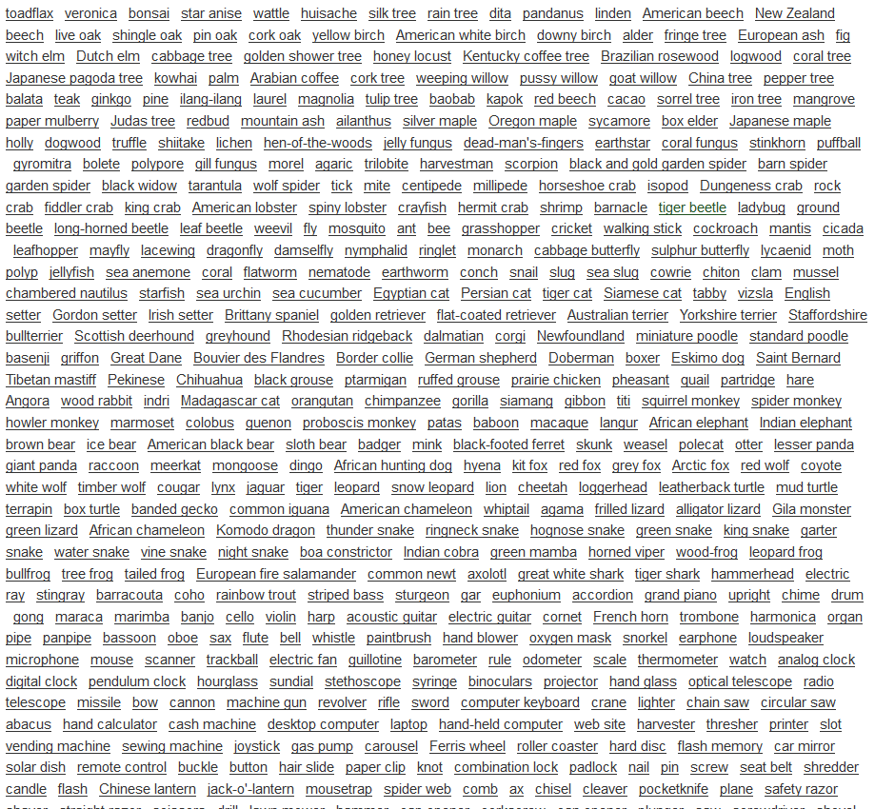

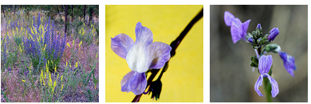

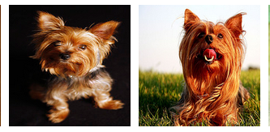
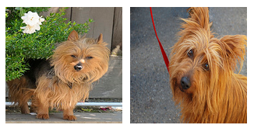
The Data
roughly 1000 images
per category
1000 categories
1 Million images
many similar
many exotic categories
close up and zoomed out
Source: http://www.image-net.org/

Slide 7
Convolution Neural Networks (CNN)
Great for random localization of the object
Generalizes well in first layers
Has been shown to work great for computer vision

Slide 8
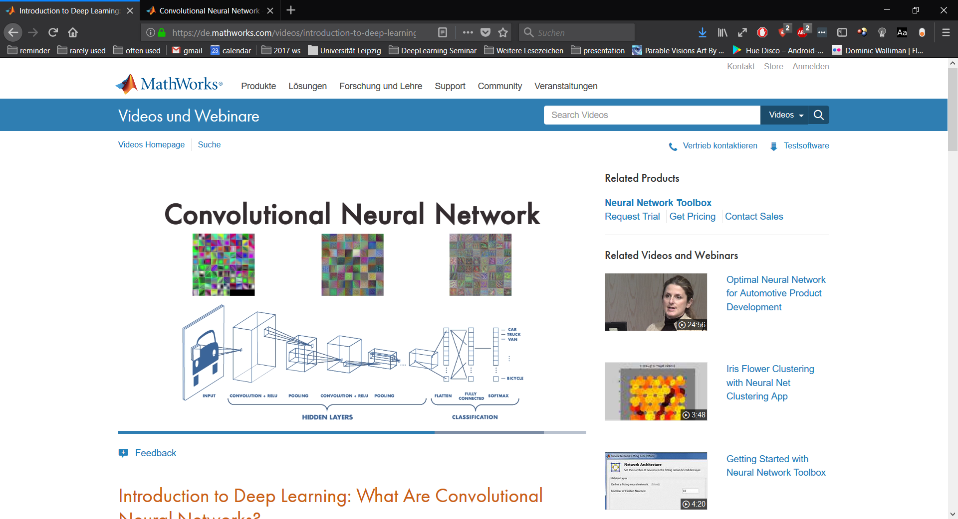
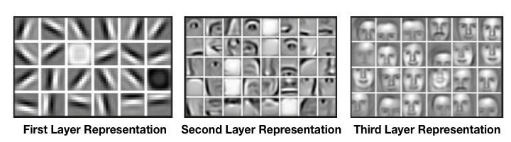
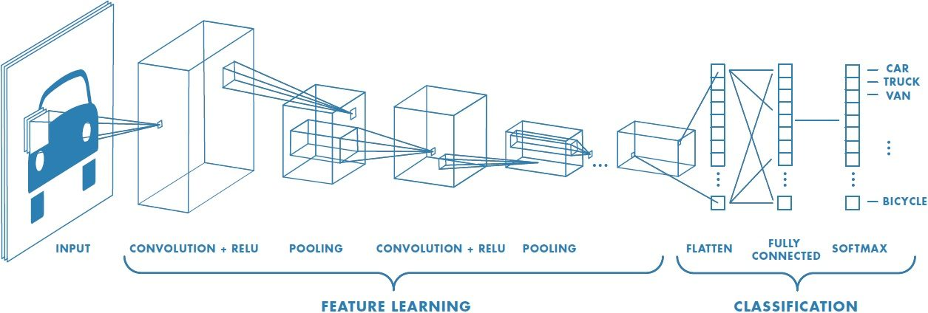
The Architecture
Source: www.mathworks.com/

Slide 9
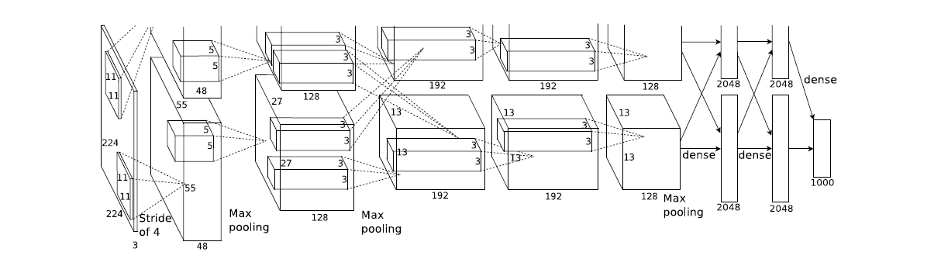
The Architecture – Overview
650.000 neurons, 60.000.000 parameters, 630.000.000 connections
final Run : 2 GPUs trained over 6 days

Slide 10
Avoiding Overfitting
Models with high accuracy and big data numbers overfit easily
Generalization ←→ High Accuracy
Counter-steps:
  Data augumentation
  Convolutional network
  Split network to reduce dependencies
  Dropout

Slide 11
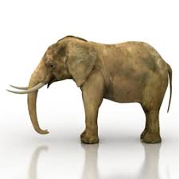
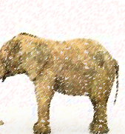
The Transformations
Decrease resolution to 256x256 pixel
Create Subpictures 224x224 pixel
Reflect Horizontally
Subtracting mean RGB value
→ Increasing Data amount without more data
Source: www.free3d.com

Slide 12
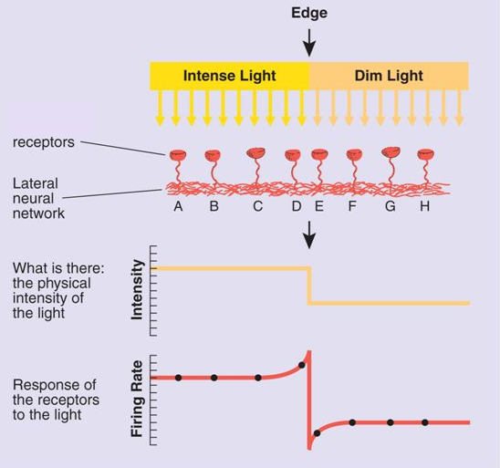
The Architecture – Local Response Normalization
inspired by real neurons
normalizes the layer:
  → high activity neurons sensitivity
  → low activity neurons sensitvity
  → functionally equal to a lateral inhibition
Source: www.wikipedia.org
Notes:
from small to big

Slide 13
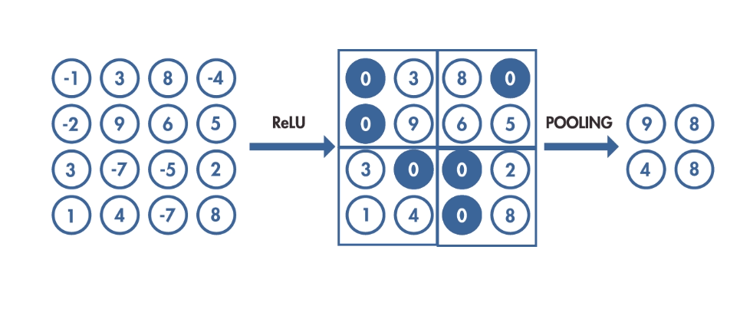
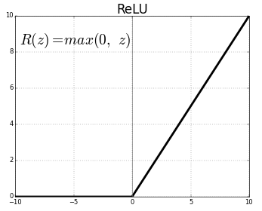
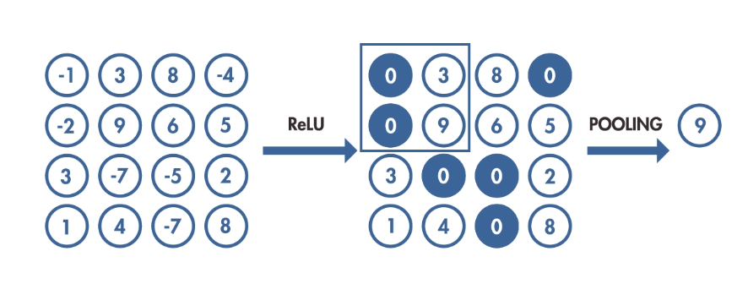
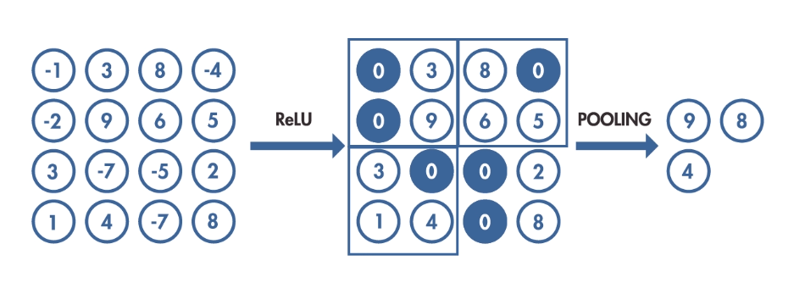
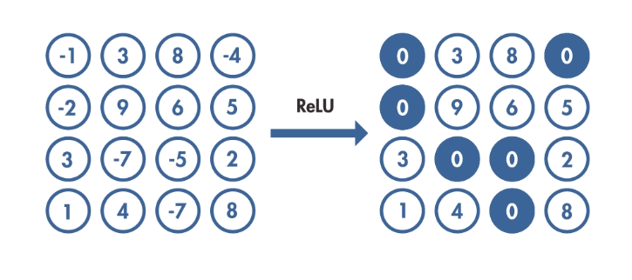

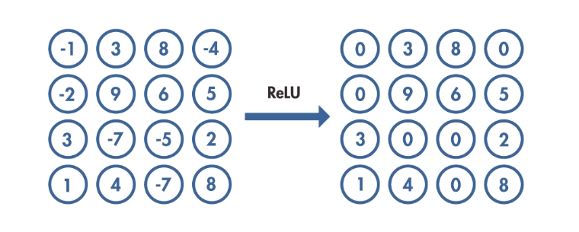
The Architecture – ReLu and Pooling
ReLu as activation function → significantly reduces learning-time
Pooling to generalize better
Source: www.mathworks.com/
Notes:
Rectified linear units

Slide 14
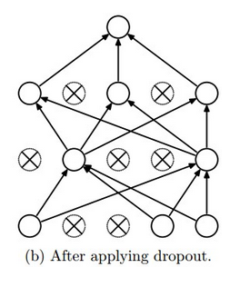
The Architecture – Dropout
50% of all neurons per image are „dead-ends“
→ Dependency/coadaption of neurons is
made impossible
→ better generalization
effect of creating a mean of millions of
different networks
  → alternative to mixing many models output
Source: www.mathworks.com/

Slide 15
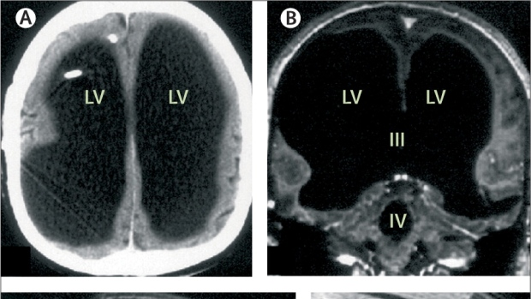
The Architecture – Dropout
Dropout creates a network that:
  is resistant to removal of neurons
  becomes more efficient with less dependencies
Source: www.aerzteblatt.de
Notes:
44 year old man with 30 year untreated hydrocephalus who hasn’t noticed difference in life
lost 85% of brain due to waterbuildup; IQ 80, wife, 2 children, works at a French governmental office

Slide 16
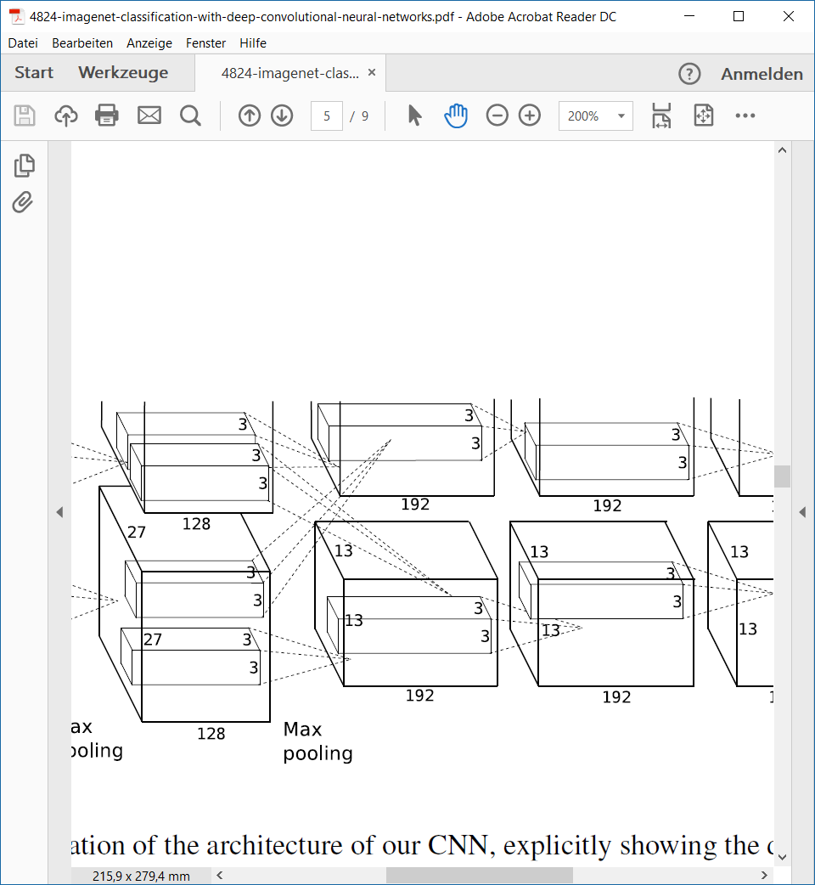
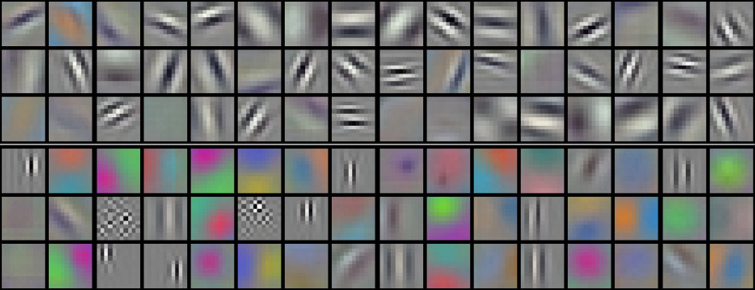
The Architecture – Split Network
→ Leads to functional split of the network
Source: Olga Russakovsky et al 2015

Slide 17
The Architecture – Multiple GPUs
2 GTX 580 GPUs used
  → initially used to expand memory
  had other beneficial effects
modern GPUs ideal for parallel processing
GPUs can write and read from each other without going over host machine memory

Slide 18
Results
Main Image
Euclidian Distance/ less similar
LSVRC-2012:
  Top-1 Error Rate of 26,7%
  Top-5 Error Rate of 15,3%
Euclidian distance as metric for similarity
Certain pictures rated similar despite:
  Angle
  Specific motif
  Lighting
  Background
→ Generalizes well
Source: Olga Russakovsky et al 2015
Notes:
another metric to show how well a network generalizes

Slide 19
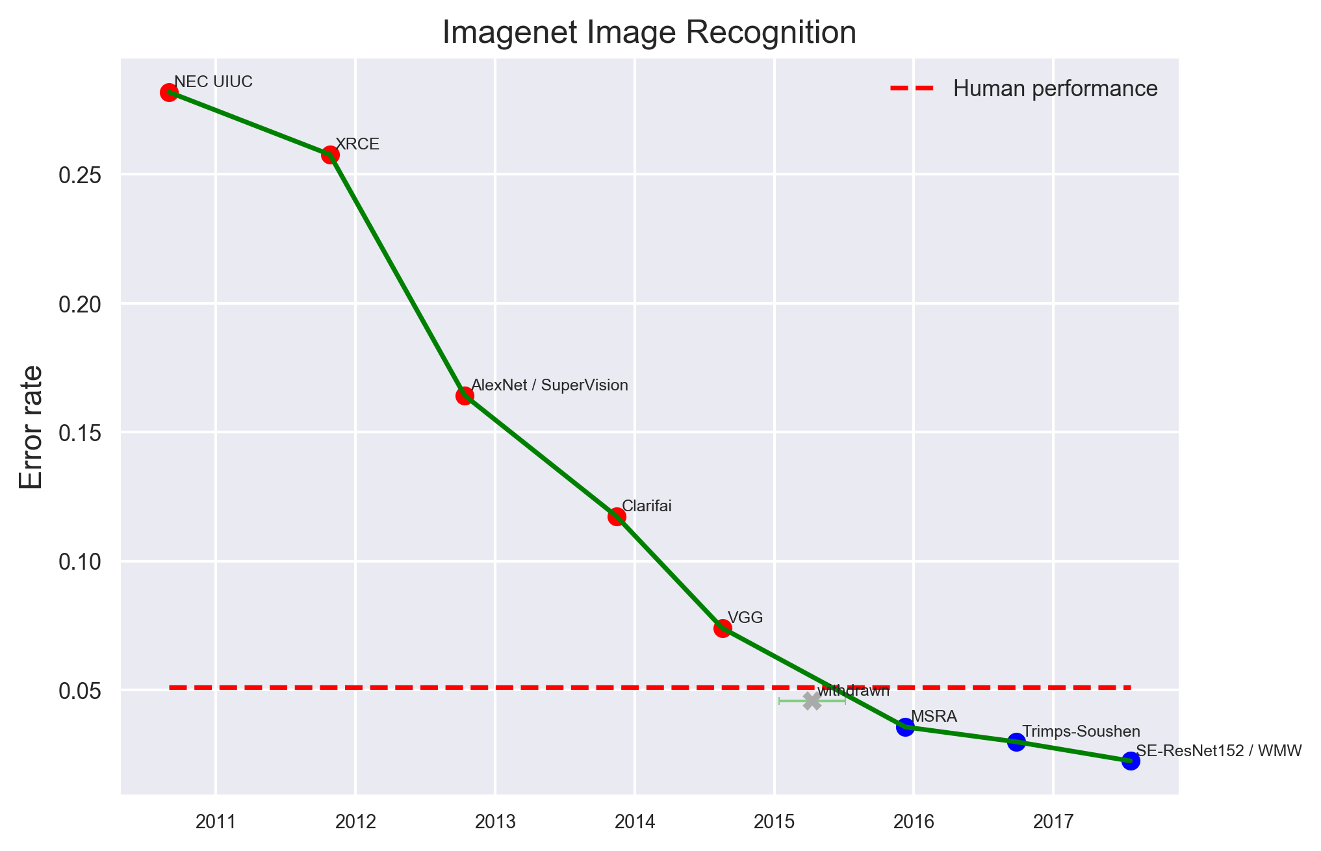
Progress since 2010 – Top 5 Error Rate
Source: www.eff.org
Notes:
The first annotator (A1) trained on 500 images and annotated 1500 test images. The second annotator (A2) trained on 100 images and then annotated 258 test images.

Slide 20
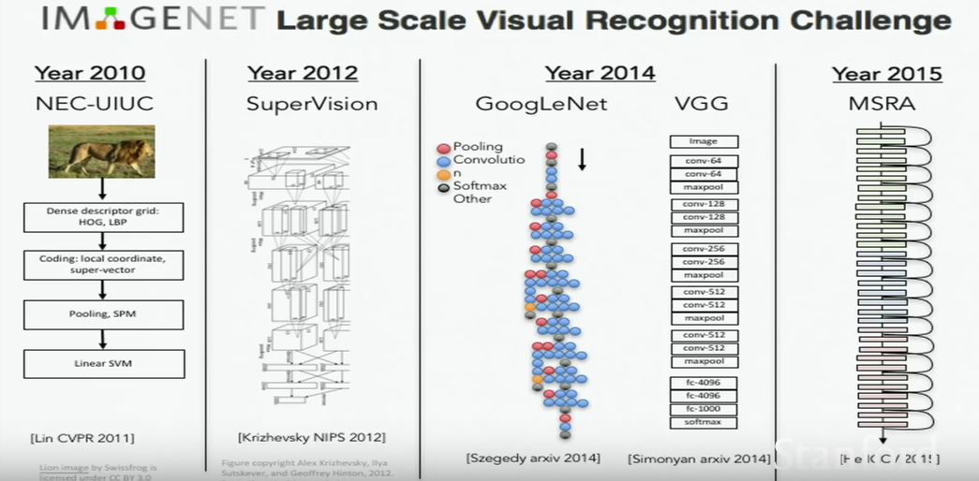
Progress since 2010
Source: www.eff.org

Slide 21

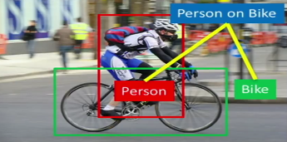
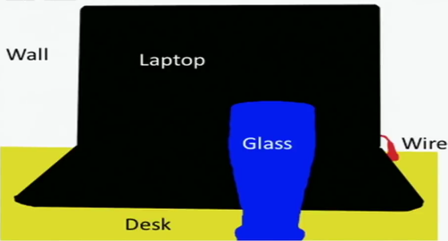
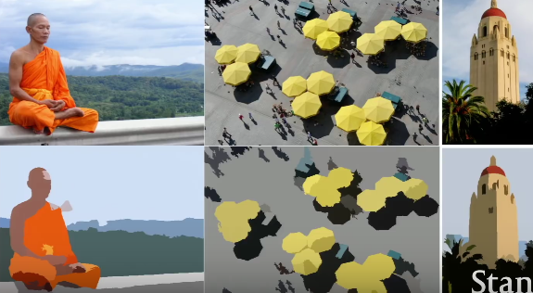
Vision of the Future
Videos as source
Adding bounding boxes
Adding image segmentation
Combinations
Source: www.youtube.com
Source: medium.com
Source: www.medium.com
Source: www.stanford.edu

Slide 22
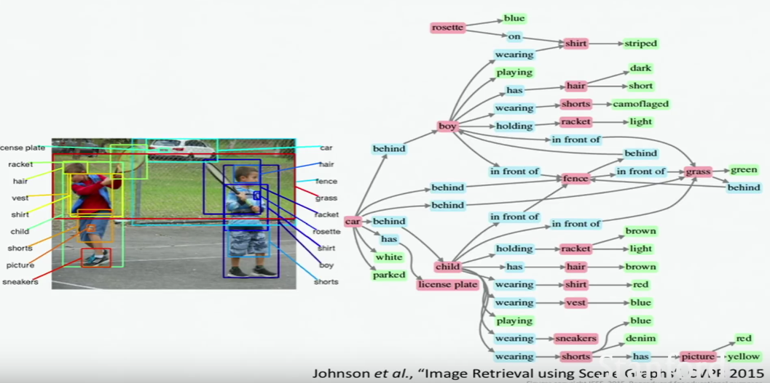
Vision of the Future
Building contextual vision based maps → Understanding

Slide 23
Discussion
Top 1 – Error Rate is yet not that high
Human Error Rate hard to specify (Dependent on dataset)
What will all this mean in a social context (Jobs, Human – Computer Interaction, etc.) ?
What potential benefits and harm can come from this?

Slide 24
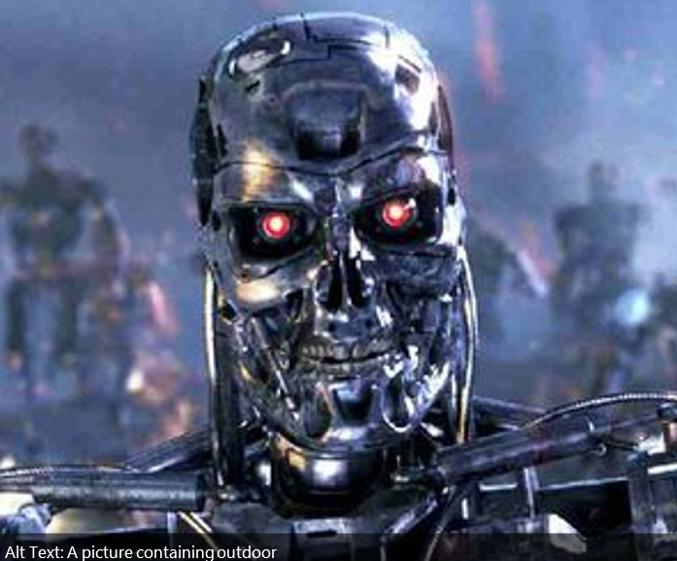
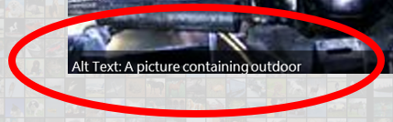
Discussion
?
Top 1 – Error Rate is yet not that high
Human Error Rate hard to specify (Dependent on dataset)
What will all this mean in a social context (Jobs, Human – Computer Interaction, etc.) ?
What potential benefits and harm can come from this?
Notes:
Alt Text recommended by Office 2016 as Description
Maybe commercially not yet far enough/practical

Slide 25
Sources
Papers
Olga Russakovsky*, Jia Deng*, Hao Su, Jonathan Krause, Sanjeev Satheesh, Sean Ma, Zhiheng Huang, Andrej Karpathy, Aditya Khosla, Michael Bernstein, Alexander C. Berg and Li Fei-Fei. (* = equal contribution) ImageNet Large Scale Visual Recognition Challenge. IJCV, 2015
[2] J. Deng, O. Russakovsky, J. Krause, M. Bernstein, A. Berg, L. Fei-Fei. Scalable multi-label annotation. ACM conference on human factors in computing (CHI), 2014
O. Russakovsky, J. Deng, Z. Huang, A. Berg and L. Fei-Fei, Detecting avocados to zucchinis: what have we done, and where are we going?, Proceedings of the International Conference of Computer Vision (ICCV). 2013.
H. Su, J. Deng, L. Fei-Fei. Crowdsourcing Annotations for Visual Object Detection. AAAI Human Computation Workshop, 2012.
J. Deng, W. Dong, R. Socher, L.-J. Li, K. Li and L. Fei-Fei, ImageNet: A Large-Scale Hierarchical Image Database. IEEE Computer Vision and Pattern Recognition (CVPR), 2009.
Websites
http://image-net.org
http://mathworks.com
http://stanford.edu
Books
Deep Learning – by Ian Goodfellow, Yoshua Bengio, Aaron Courville

