Slide 1
Don't Match Twice: Redundancy-free Similarity Computation with MapReduce
New York, DanaC 2013
Lars Kolb, Andreas Thor, Erhard Rahm
Database Group Leipzig
University of Leipzig

Slide 2
Pairwise Similarity Computation (PSC)
Example applications
Document clustering
Set-similarity joins in databases
Entity Resolution
Characteristics
O(n²)
Complex similarity functions
Optimizations
Clustering
Parallelization

Slide 3
Clustering-based PSC
“Samsung”
“Sony”
Appropriate signature creation crucial for data quality
Efficiency vs. quality
Noisy, missing, inconsistent attribute values
Partition by manufacturer
Partition by product type
Multiple signatures
Improve pairs completeness
Redundant evaluation of the same objects
Duplicates in result
“mp3”
“mobile phone”

Slide 4
Avoidance of Redundant Pairs
Objects o_{1,} o₂ with signatures
$σ$(o₁) = {2, 4, 7}
$σ$(o₂) = {2, 3, 4, 7}
Requirement
Compare o₁, o₂ for a single s $∈$ $σ$(o₁) $∩$ $σ$(o₂) only
Either for 2 or for 4
Distributed environment
Object pairs are independently processed on different nodes
Each node must determine the same signature
Without any communication
“Least common signature”: s = min($σ$(o₁) $∩$ $σ$(o₂))
Compare o_{1,} o₂ for signature 2 (and skip comparison for signature 4)

Slide 5
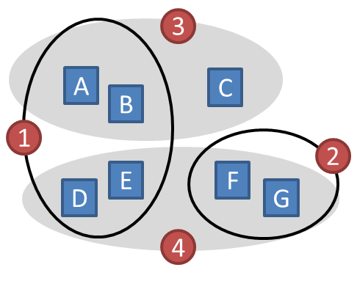
MapReduce-based Avoidance of Redundant Pairs
Map: Signatures
Reduce: Pair Comparisons
Key | Value
1 | A, {1,3}
3 | A, {1,3}
1 | B, {1,3}
3 | B, {1,3}
3 | C, {3}
1 | D, {1,4}
4 | D, {1,4}
Partitioning by hash(Key) modulo r
Key | Value
1 | A, {1,3}
1 | B, {1,3}
1 | D, {1,4}
1 | E, {1,4}
3 | A, {1,3}
3 | B, {1,3}
3 | C, {3}
Obj
A
B
C
D
Pairs
A-B, A-D, A-E, B-D, B-E, D-E
A-B, A-C, B-C
Object | Signature
A | {1, 3}
B | {1, 3}
C | {3}
D | {1, 4}
E | {1, 4}
F | {2, 4}
G | {2, 4}
3 $≠$ min({1,3}$∩${1,3})
Key | Value
1 | E, {1,4}
4 | E, {1,4}
2 | F, {2,4}
4 | F, {2,4}
2 | G, {2,4}
4 | G, {2,4}
Key | Value
2 | F, {2,4}
2 | G, {2,4}
4 | D, {1,4}
4 | E, {1,4}
4 | F, {2,4}
4 | G, {2,4}
Pairs
F-G
D-E, D-F, D-G, E-F, E-G, F-G
Obj
E
F
G
4 $≠$ min({1,4}$∩${1,4})
4 $≠$ min({2,4}$∩${2,4})
3 costly operations for each pair: Set intersection + min + key comparison

Slide 6
MapReduce-based Avoidance of Redundant Pairs (2)
Map: Signatures
Reduce: Pair Comparisons
Annotate A with all of its signatures < 1
Annotate A with all of its signatures < 3
Key | Value
1 | A, ∅
3 | A, {1}
1 | B, ∅
3 | B, {1}
3 | C, ∅
1 | D, ∅
4 | D, {1}
Partitioning by hash(Key) modulo r
Key | Value
1 | A, ∅
1 | B, ∅
1 | D, ∅
1 | E, ∅
3 | A, {1}
3 | B, {1}
3 | C, ∅
Obj
A
B
C
D
Pairs
A-B, A-D, A-E, B-D, B-E, D-E
A-B, A-C, B-C
Object | Signature
A | {1, 3}
B | {1, 3}
C | {3}
D | {1, 4}
E | {1, 4}
F | {2, 4}
G | {2, 4}
{1}$∩${1} $≠$ ∅
→ they have a common signature <3)
Key | Value
1 | E, ∅
4 | E, {1}
2 | F, ∅
4 | F, {2}
2 | G, ∅
4 | G, {2}
Key | Value
2 | F, ∅
2 | G, ∅
4 | D, {1}
4 | E, {1}
4 | F, {2}
4 | G, {2}
Pairs
F-G
D-E, D-F, D-G, E-F, E-G, F-G
Obj
E
F
G
{1}$∩${1} $≠$ ∅
Optimizations:
Reduction of intermediate data
Set intersection + min + key comparison → Overlap check of sorted list
{2}$∩${2} $≠$ ∅

Slide 7
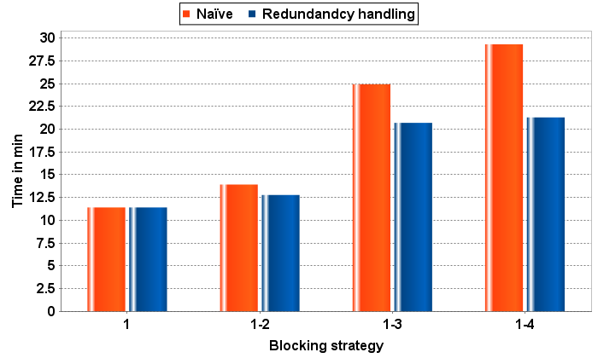
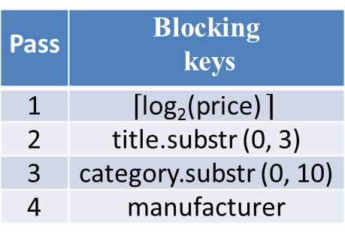
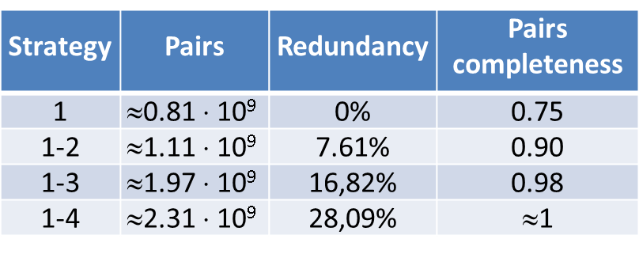
Experimental Evaluation
Dedoop prototype for MR-based entity resolution (VLDB 2012)
114,000 (noisy) electronic product offers
Hadoop 0.20.2@EC2 (20 worker VMs of type c1.medium)
Multiple signatures crucial for data quality
Substantial degree of redundant pairs
Run-time savings proportional to the cluster overlap

Slide 8
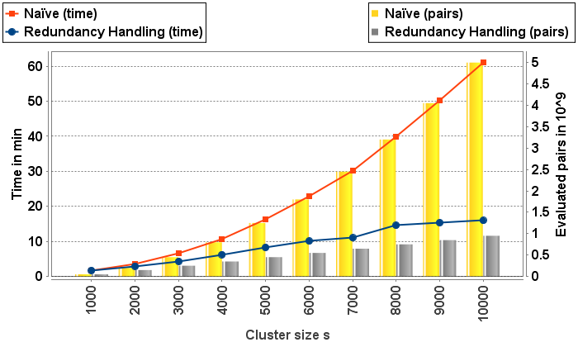
Experimental Evaluation (2)
Subset of n=100,000 offers, same environment
Systematical variation of the degree of redundancy
Fix number of offers and clusters but increase cluster
Naïve
Execution time grows proportional to the number of comparisons
Reduncancy-free PSC
Completes much faster (with same recall)
4 x faster for s=10,000

Slide 9
Conclusions
Summary
PSC becomes feasible by
Clustering to reduce the search space
Parallelization with MapReduce
Multiple clustering passes
Improve robustness
Lead to redundant processing of object pairs
Simple but effective approach to skip redundant pairs
Compare o₁, o₂ for s = min($σ$(o₁) $∩$ $σ$(o₂))
Future work
Least common signature approach introduces computational skew
Determine the single s $∈$ $σ$(o₁) $∩$ $σ$(o₂) pseudorandomly

Slide 10
Thank you for your attention

